Slide 1

MEDICAL STUDENTS’ EXCHANGE PROGRAM
SERBIAN MEDICAL STUDENTS’ ASSOCIATION
Novi Sad Belgrade Kragujevac Nis Kosovska Mitrovica
2/4 weeks program at Medical Faculty of Belgrade University
SCHOOL YEAR 2022/2023.
INFORMATION PACKAGE FOR MEDICAL STUDENTS AND YOUNG DOCTORS
www.srmsa.net

Slide 2
SERBIAN MEDICAL STUDENTS’ ASSOCIATION
Dear colleagues,
It is our great pleasure to welcome you to take part in our medical practice program in Belgrade, Republic of Serbia.
Since year 2007. we regularly accept medical students and young doctors. Due to Covid-19 pandemic our program was paused from during two years, 2020. & 2021
Guest students and young doctors have all activities at University Clinics of Belgrade School of Medicine, under supervision of assigned mentors.
Our program is developed and supported by University of Belgrade Scool of Medicine, University hospitals and Goverment of Serbia. Activities are coordinated with institutions and quality of program is evaluated at the end of each school year.
Dr spec. med. Aleksandar Ljuboja
SrMSA Belgrade Coordinator

Slide 3
SERBIAN MEDICAL STUDENTS’ ASSOCIATION
OFFICIAL LANGUAGES ARE:
ENGLISH AND SERBIAN
► You are free to use other languages if you and your tutor can understand each other.

Slide 4

SERBIAN MEDICAL STUDENTS’ ASSOCIATION
PRACTICE
► You will practice in Univeristy Hospitals.
► University hospitals of Belgrade Medical Faculty are most respecatble in Serbia and South-Eastern Europe.
► Our tutors are prominent medical professionals in their specialties.

Slide 5
SERBIAN MEDICAL STUDENTS’ ASSOCIATION
DEPARTMENTS
► Please, when registering for program, inform us about desired departments.
► You should write three choices since it may happen that you won’t be able to practice at one that you wish the most.
► All departments are available, but with limited number of students – please, keep in mind that early registration gives you more chances for your most wished department.

Slide 6
SERBIAN MEDICAL STUDENTS’ ASSOCIATION
ACCOMODATION
► Program participants are usually accommodated in Hostel or private apartments which are clean and secure. Rooms might be mixed, so it may happen that boys and girls share room during stay, which is usual in our city.
► Accommodation that we organize is preferably near University hospitals and City Center, or in wider center.
► These areas are well connected by public transportation with all parts of Belgrade.

Slide 7
SERBIAN MEDICAL STUDENTS’ ASSOCIATION
HOW TO REGISTER?
► Complete APLICATION FORM (available from your local coordinator)
Choose:
Period of time when you would like to come in Belgrade (2 or 4 weeks)
Department (first choice and two alternatives)
INVITATION LETTER
We will provide you with invitation letter .
You will have to confirm us that you received Invitation letter and introduce yourself in few lines, by sending e-mail to us ► srmsa.belgrade@zoho.com

Slide 8
SERBIAN MEDICAL STUDENTS’ ASSOCIATION
FOLLOWING STEPS I - DOCUMENTS
Documents you need to obtain for our University.
List of needed documents:
- Training form*
- Mobility form*
- Certificate that you are student or medical doctor
- Photo/Copy or scan of first pages of your passport
- Certificate of Covid -19 vaccination
*We will provide you with forms and instructions.

Slide 9
SERBIAN MEDICAL STUDENTS’ ASSOCIATION
FOLLOWING STEPS II - ARRIVAL
Arrival and departure information.
As soon as you organize your travel => inform us by e-mail about arrival and departure.
► During one week before arrival we will communicate with you directly and send details considering your arrival and accommodation in hostel/private apartment.
~ Our team will provide needed support from the day of arrival ~

Slide 10
SERBIAN MEDICAL STUDENTS’ ASSOCIATION
COMMUNICATION I – E-MAILS
After you introduction mail we will be mostly in touch by e-mails
► HOW TO WRITE AND SEND E-MAIL TO US?
We suggest you to write in subject line “your name and last name, topic”
for example: “Boris Medvedev – documents”
“Ana Pavlovna – flights”, etc.
~ We will guide you through all steps that we mentioned ~

Slide 11
SERBIAN MEDICAL STUDENTS’ ASSOCIATION
COMMUNICATION II – MOBILE PHONES
When needed faster communication we suggest phone:
Viber
What’s up
Telegram
Direct calls and sms (if urgent!)
► We will give you phone numbers of coordinators. Our coordinators will answer you some particular questions.

Slide 12
SERBIAN MEDICAL STUDENTS’ ASSOCIATION
PAYMENT
Registration fee depends on time of year you are planning to come in Belgrade, and also registration and payment time!
► Prices for unilateral fees are listed on next 2 slides
Registration fee includes reception at Airport, accommodation, lunch during working days for 2, 3 or 4 weeks period (10, 15 or 20 lunches).
*If we don’t organize lunch coupons we will refund you with 5 euros per lunch – this is daily lunch price at students restaurant.
► Serbian traditional barbeque at Ada lake or Dinner at National restaurant is free of charge (also included as part of social program)

Slide 13
SERBIAN MEDICAL STUDENTS’ ASSOCIATION
REGISTRATION FEE PRICES SUMMER PRACTICE JULY/AUGUST
Early registration and payment – until 1.3.2023.
2 weeks 390 Euros
3 weeks 450 Euros
4 weeks 490 Euros
Late registration and payment – until 15.5.2023.
2 weeks 470 Euros
3 weeks 550 Euros
4 weeks 600 Euros

Slide 14
SERBIAN MEDICAL STUDENTS’ ASSOCIATION
REGISTRATION FEE PRICES OTHER MONTHS (NOT JULY AND AUGUST)
* No active social program
Early registration and payment – up to 3 months before arrival
2 weeks 500Euros
3 weeks 650 Euros
4 weeks 730 Euros
Late registration and payment – up to one month before arrival
2 weeks 590 Euros
3 weeks 720 Euros
4 weeks 800 Euros
* If you are coming in couple or 2-4 students together, who are agreed to share accommodation then we will provide 10-20% discount price for each.

Slide 15
SERBIAN MEDICAL STUDENTS’ ASSOCIATION
HOW TO PAY REGISTRATION FEE
Our team will provide you with information how to pay by Bank or direct money transfer (Western Union, RIA, MoneyGram, etc.)
► It is available for you to total amount by bank or direct money transfer, or you can pay crucial part this way, while you can pay rest of the amount in cash upon arrival. If you choose to pay in two parts, cash part is always 150euros.
► For example: Registration fee is 490 euros, your advance payment by bank or direct money transfer is 340 euros, and you have to pay 150euros upon arrival.
► By this way you may also pay lower provisions for money transfer and spent less money at time of registration.

Slide 16
SERBIAN MEDICAL STUDENTS’ ASSOCIATION
HOW LONG YOU CAN STAY?
You can arrive from first day and stay until last day stated in your invitation letter, not before not later.
► Up to max. 30 days
WHEN WILL YOUR PRACTICE START?
Your practice will start in first 3-4 days of your arrival, mostly 2nd or 3rd day. Rarely your practice may start later (it happens if your assigned tutor is not at the Clinic at exact time of your arrival).

Slide 17
SERBIAN MEDICAL STUDENTS’ ASSOCIATION
Covid-19 rules for guest students
► All participants in program should be fully vaccinated against SARS-CoV-2 (all vaccines are accepted!)
► If University or host Clinic asks for Antigen or PCR test on SARS-CoV-2, not older then 72h before beginning of practice you will be aditionally infromed (at least 2 weeks before program starts)
► All other regulations considering Covid-19 mesaures of Serbian health department will be announced at least 2 weeks before your arrival.

Slide 18
SERBIAN MEDICAL STUDENTS’ ASSOCIATION
WHEN YOU WILL GET CERTIFICATE?
► You need to complete at least 2/3 of program duration.
After successful fulfillment of the requirements of “Medical students’ exchange program” you will be issued official certificate.
► SrMSA official certificate includes signatures of exchange coordinator / SrMSA President, assigned mentor and stamps of SrMSA and Host Clinic at University of Belgrade School of Medicine.

Slide 19
SERBIAN MEDICAL STUDENTS’ ASSOCIATION
CAUTION
This invitation is created for our colleagues, medical students (from 3rd year and above) and young medical doctors.
If you choose to practice in Belgrade please be aware that you represent your University and your country, and also our respected profession. We expect that you will give your best in these activities and that you will communicate in best manner with our team, tutors and other people and institutions involved in program.
If there is any problem caused by you SrMSA and University of Belgrade Medical School may take needed measures, such as cancellation of your practice or stay in Hostel.

Slide 20
SERBIAN MEDICAL STUDENTS’ ASSOCIATION
SOCIAL PROGRAM I – SrMSA TRADITIONAL
► Serbian traditional BBQ or dinner at National restaurant (free of any charges)
2nd / 3rd week of July and 2nd / 3rd week of August
► Our team will prepare you delicious food for which Serbia is known worldwide, in beautiful surroundings of Ada lake or we will choose nice restaurant .
► SERBIAN SPIRITS NIGHT 1st / 4th week of July and 1st /4th week of August
Students will have opportunity to choose between several well known pubs where we will taste the most popular Serbian spirits at discounted prices (Rakia bar, Serbian beer house,…) – One welcome drink comes free!
* BBQ or DINNER, also SPIRITS NIGHT will be available for students present at stated time, not for each group
For more info join SrMSA Facebook community / www.srmsa.net

Slide 21
SERBIAN MEDICAL STUDENTS’ ASSOCIATION
SOCIAL PROGRAM II – EXCURSIONS ON DEMAND
► Field trips to some famous destinations in Serbia and region (Bosnia and Hercegovina, Montenegro…) will be offered on demand.
► Depending on interest excursion program may be created by our organization or by reputable tourist organizations – after interest you will get proposed program and prices for individuals or group.
► Suggested excursions: Avala tower, Topola and Oplenac, Novi Sad with Fruska gora wineries, Petroland Aquapark, Nis, Zlatibor, Palic…
For more info join SrMSA Facebook community / www.srmsa.net

Slide 22
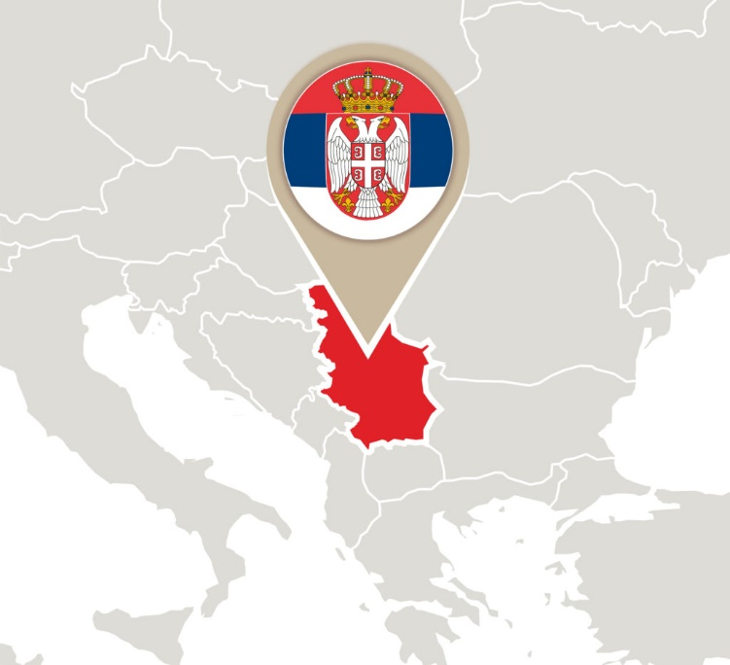
SERBIAN MEDICAL STUDENTS’ ASSOCIATION
WHERE IS SERBIA IN EUROPE?
Serbia is a country
on southeast Europe’s
Balkan peninsula

Slide 23
SERBIAN MEDICAL STUDENTS’ ASSOCIATION
WHY SERBIA?
Serbia is a sovereign state, situated at the crossroads between Western and Eastern empires, covering the southern part of the Pannonian Plain and the central Balkans. Serbia is a country on southeast Europe’s Balkan peninsula with vast northern plateaus and mountains with ski resorts to the south. Its capital is Belgrade was held successively by the Roman, Byzantine, Ottoman, and Austro-Hungarian empires. Population is mostly of Slavic origin and Orthodox Christian, while up to one third are descendants of different European nations, Islamic or Catholic and Protestant Christians. People are friendly to foreigners, well educated, with knowledge of both English and Russian languages. Living costs are low, especially out of Belgrade, with healthy organic food specialties, unique in the world. Good infrastructure and geographic position makes it good choice for world travelers. Weather is characterized by short winters, hot summers and mild springs and autumns.

Slide 24

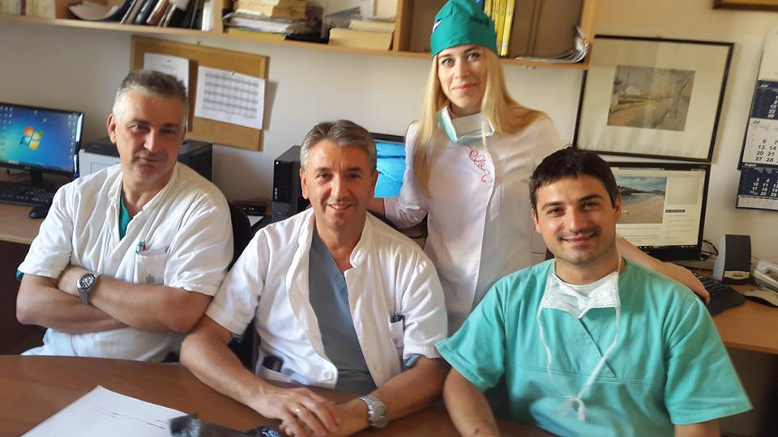
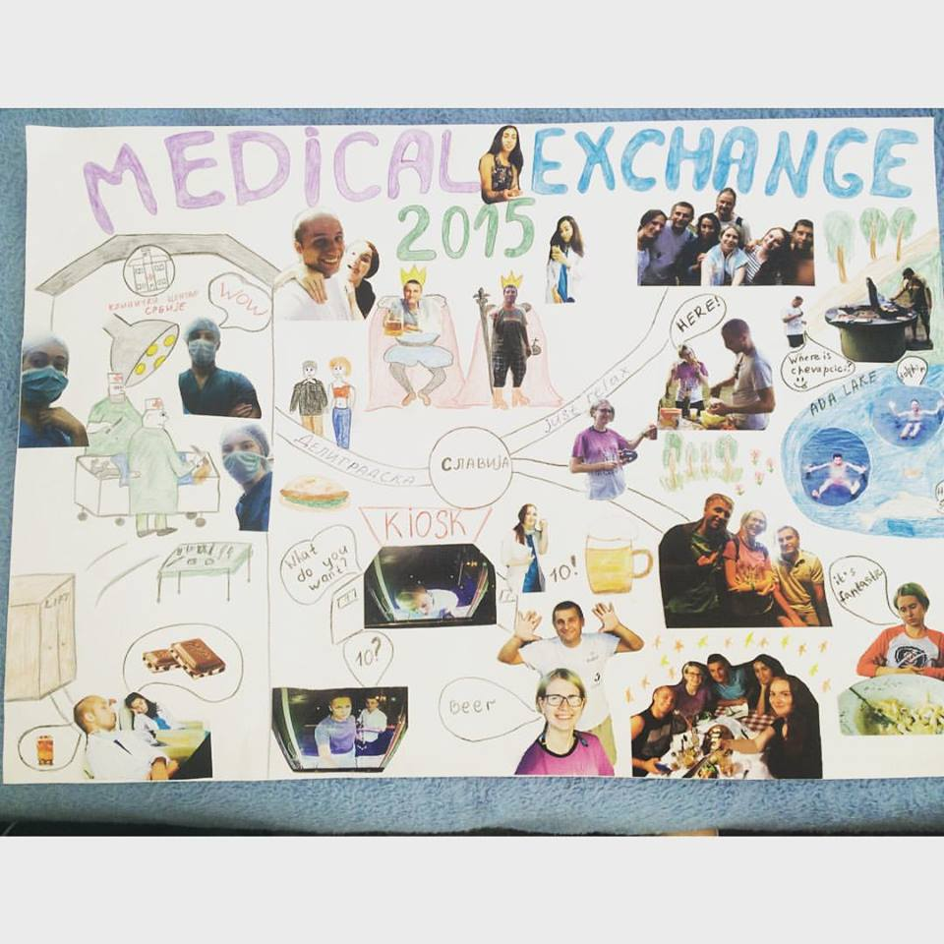
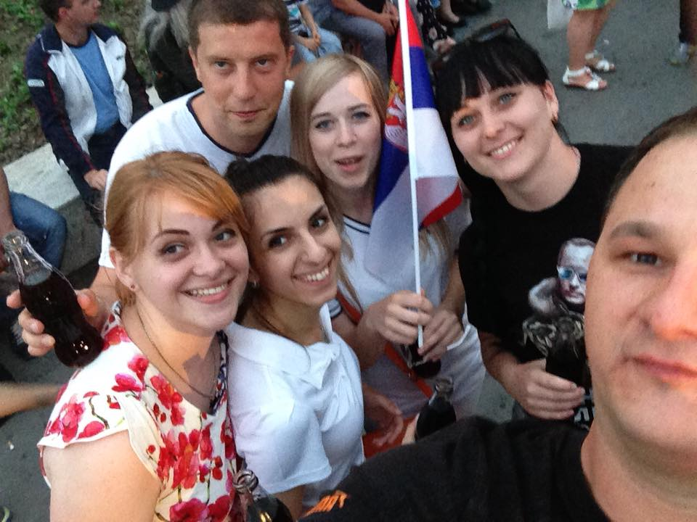
SERBIAN MEDICAL STUDENTS’ ASSOCIATION

Slide 25
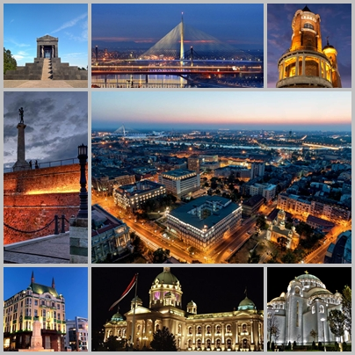
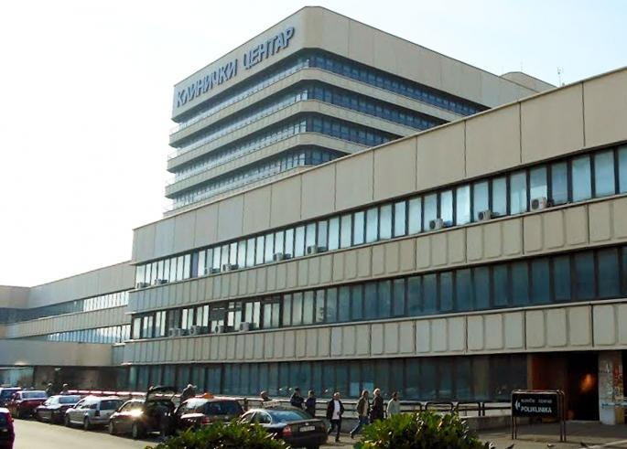
SERBIAN MEDICAL STUDENTS’ ASSOCIATION
Belgrade photo album – get to know Belgrade
Clinical Center of Serbia

Slide 26
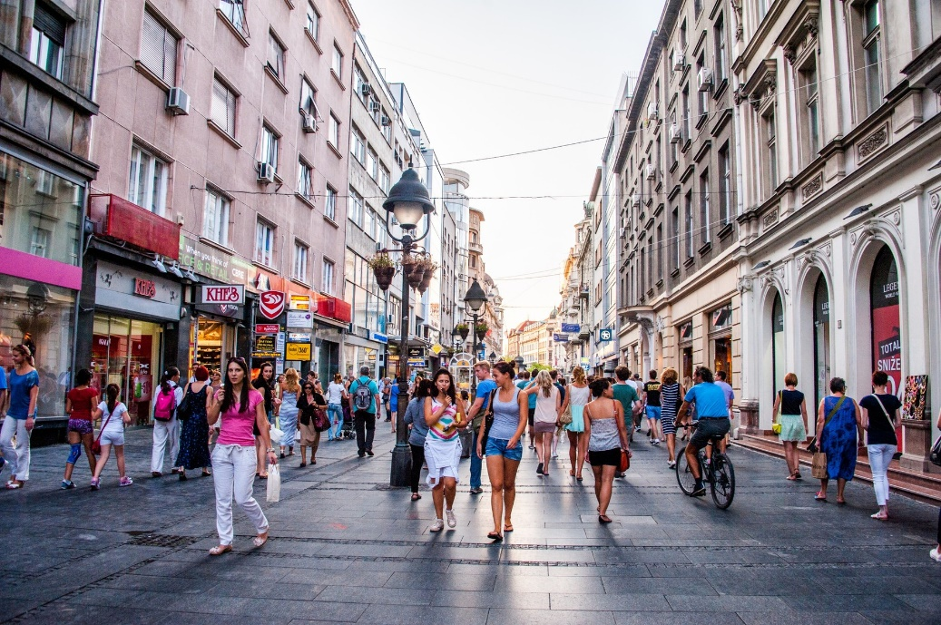
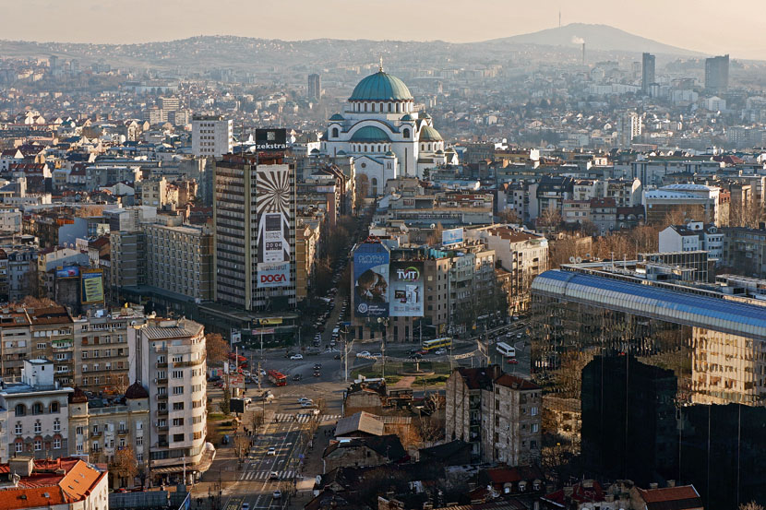
SERBIAN MEDICAL STUDENTS’ ASSOCIATION
Belgrade photo album – get to know Belgrade
City Center – Knez Mihailova street, Slavija square and St. Sava’s temple

Slide 27
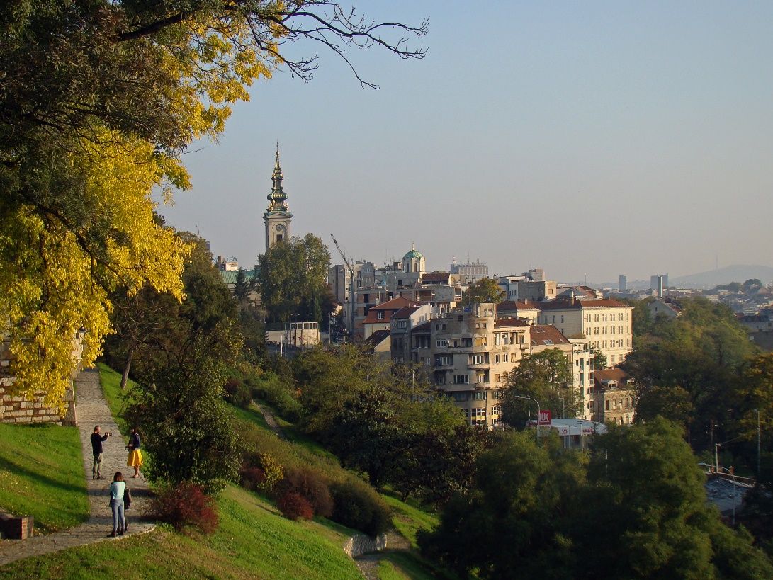
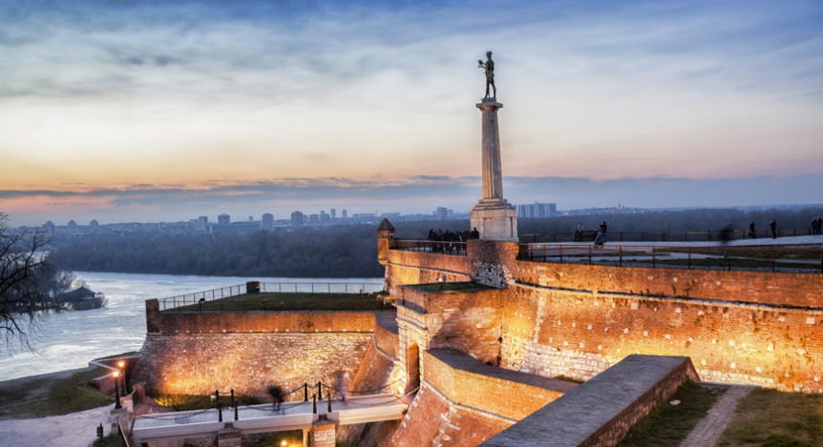
SERBIAN MEDICAL STUDENTS’ ASSOCIATION
Belgrade photo album – get to know Belgrade
Kalemegdan – old fortress, monuments, park and zoo

Slide 28

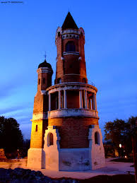
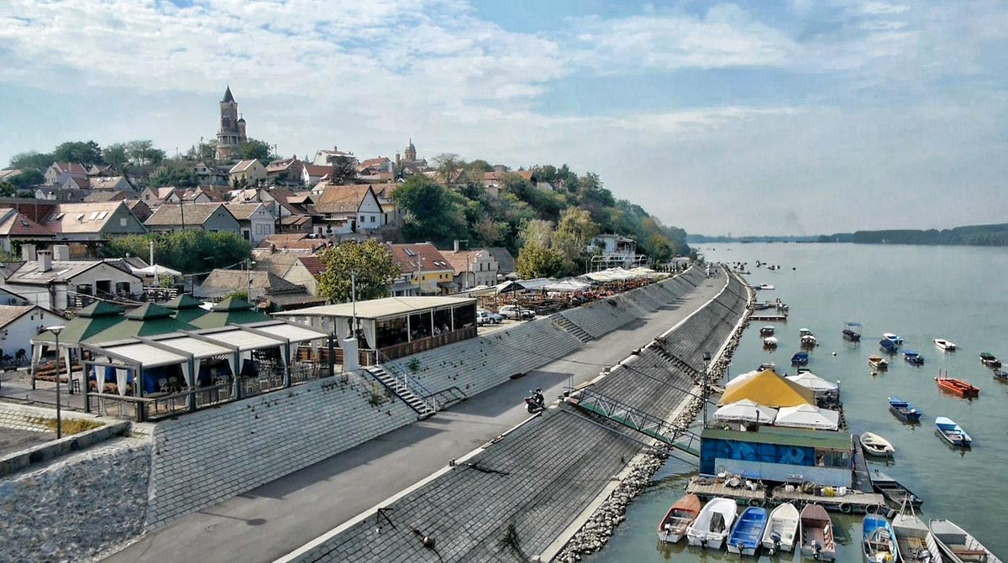
SERBIAN MEDICAL STUDENTS’ ASSOCIATION
Belgrade photo album – get to know Belgrade
ZEMUN – Gardos tower, Danube river bench and fine restaurants

Slide 29
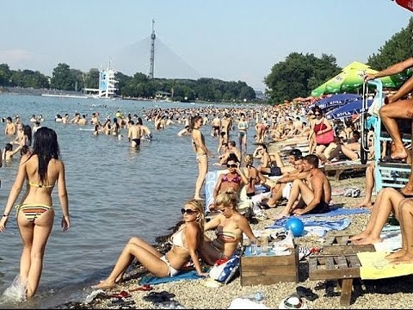
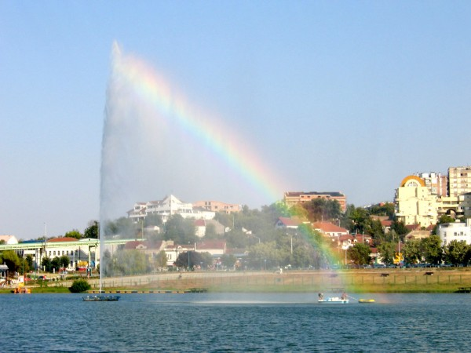
SERBIAN MEDICAL STUDENTS’ ASSOCIATION
Belgrade photo album – get to know Belgrade
Ada lake (also known as “Sea of Belgrade”)

Slide 30
SERBIAN MEDICAL STUDENTS’ ASSOCIATION
Search online for more photos of Belgrade, read more about our great City
► Belgrade is considered as one of Top European youth destinations
► Each month we have many cultural, sport and other social events
► During summer months we have Beer garden festival in July and famous Beer fest in August
► Belgrade is City of rich history and culture, known for thousands of years
Also, if you want to see more of Serbia and neighboring countries Belgrade is the best place for transport connections in this area of Europe
FIND OUT MORE at Tourist organization of Belgrade website www.tob.rs

Slide 31
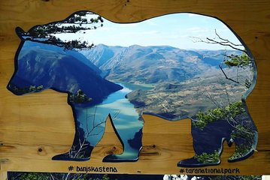
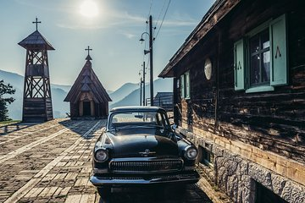
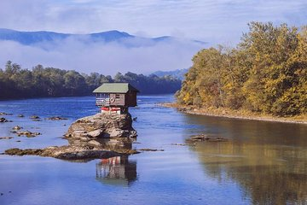
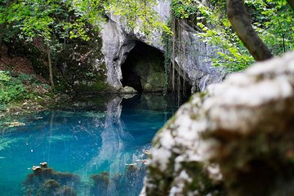
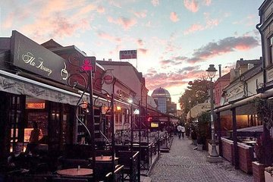
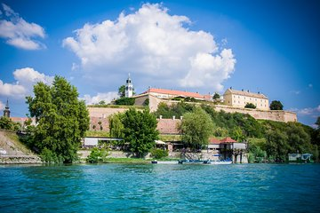
SERBIAN MEDICAL STUDENTS’ ASSOCIATION
Some of many interseting places around Serbia (avaliable for day trips)
1) Tara 2) Drvengrad 3) Drina river 4) Eastern Serbia 5) Nis 6) Novi Sad fortress

Slide 32

SERBIAN MEDICAL STUDENTS’ ASSOCIATION
We hope our program will satisfy you in both aspects
professional and social
as hundreds of colleagues in previous years!
Each year we at SrMSA are once again motivated and enthusiastic to meet new colleagues and gain new friendships.
WELCOME TO BELGRADE AND WELCOME TO SERBIA!
CONTACT US: srmsa.belgrade@zoho.com

