Slide 1

Options for internships or practical training at the bases of medical organizations in other countries

Slide 2

Internships in China (Datong)
Sendai Group of Datong Hospitals China
For students of the Faculty of General Medicine and dentists

Slide 3

Datong is a city in the central part of China, in Shaanxi Province, on the loess plateau (height 1090 m) at the outpost of the Great Wall of China, separating Inner China from Inner Mongolia. The population is 3.1 million people. Datong is located about 350 kilometers from Beijing and the capital can be reached by train or plane.

Slide 4
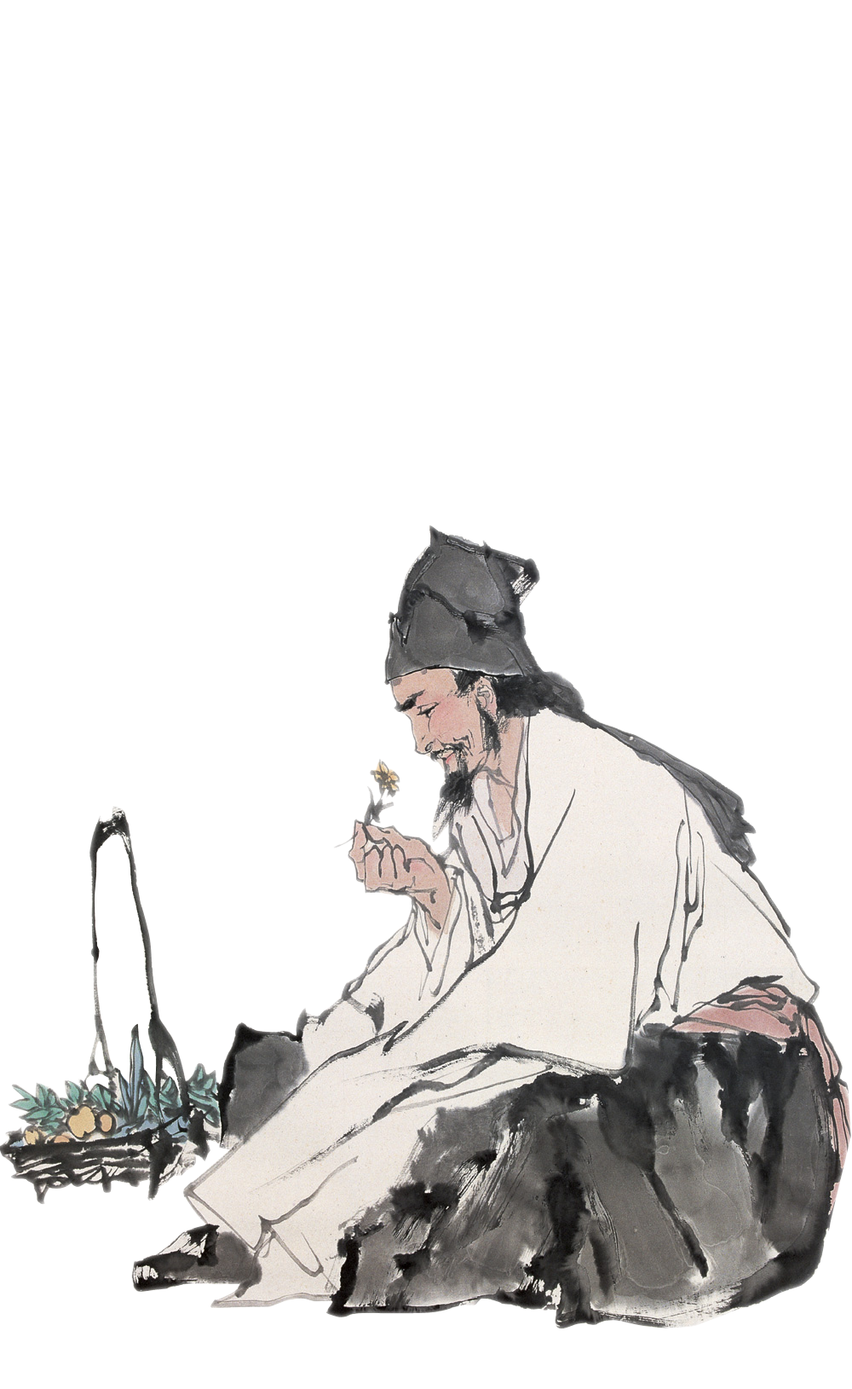
Internships for doctors in Datong
Internships in both traditional medicine and traditional Chinese medicine are available in Datong City.

Slide 5
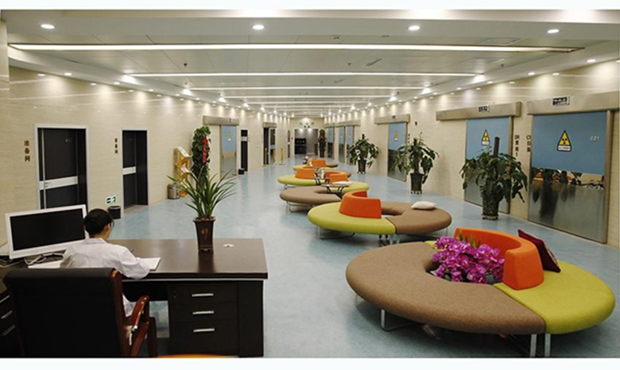
Founded in 2005, Datong Xiandai Hospital Management Co., Ltd. is headed by Datong Ruici Health Management Co., Ltd. and Datong Xiandai Hospital Management Co., Ltd. which includes 7 hospitals: Datong Xiandai Hospital, Shuozhou Xiandai Hospital, Xinzhou Xiandai Hospital, Brain Hospital Datong Xiangdai, Datong Cardiovascular Hospital, Datong Ruichi Health Hospital, Datong Nanguan Hospital.
More than 1,100 employees,
About 1,000 beds,
About 250,000 outpatient patients annually

Slide 6

Main departments
Hyperthyroidism Prevention and Treatment Center
Diabetes Rehabilitation Center
Infertility Diagnosis and Treatment Center
Digestive Medicine Center
Respiratory medicine
Cardiovascular medicine,
Encephalology (neurology, neurosurgery)
Oncology
Urology
Pediatric surgery
Head and Neck Surgery (five departments)
Traumatology and orthopedics
Spinal surgery
Hand and foot surgery
Minimally invasive gynecology, etc.

Slide 7

Requirements for interns
Certificate from the university or diploma
Internship language: Chinese, English or Russian
You need to apply at least 6 weeks in advance
It is possible to arrange accommodation – the average cost is about $ 30 per day.

Slide 8

Internship cost
1 week – 4,200 yuan + registration fee
2 weeks – 6,400 yuan + registration fee
*Registration fee – 40,000 rubles
Included: certificate, meeting at the Beijing airport.

Slide 9


Additional internship opportunities in China
Harbin Medical University
Internship conditions
The road and meals are paid for independently
A dormitory is provided
They organize training, cultural and sports events there
Certificates are issued
Group short-term internships (10-15 people) for 1-2 weeks
For several people for a period of 1 month

Slide 10

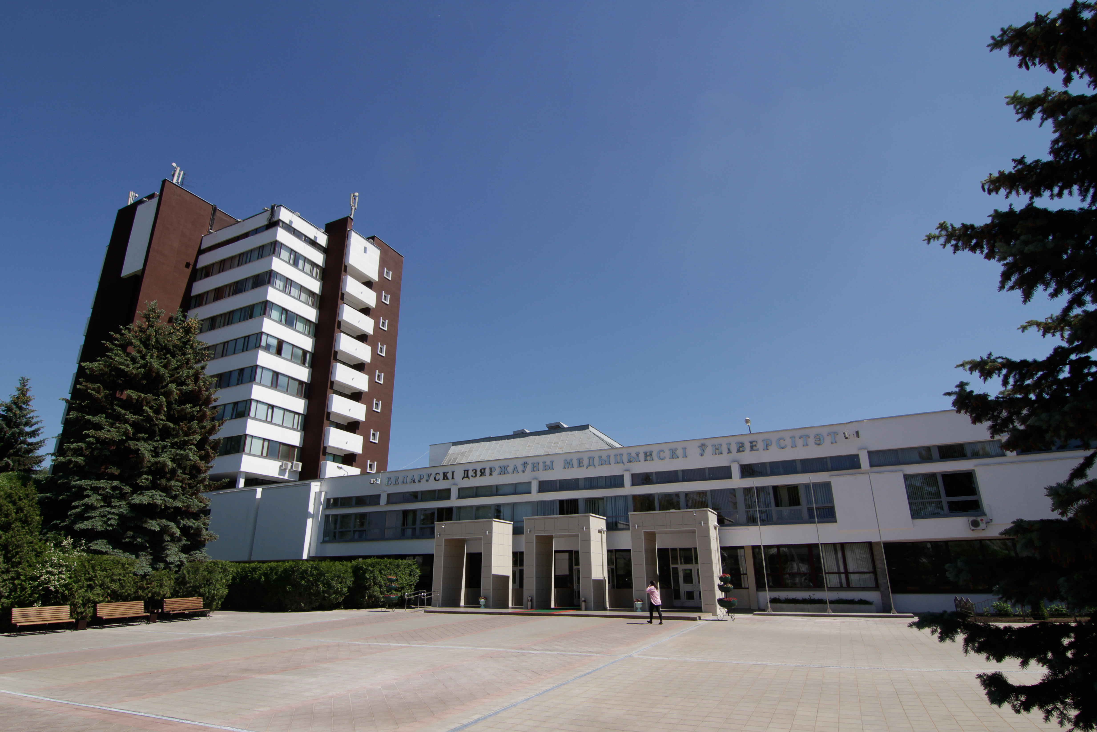
Internship at the Belarusian State Medical University in 2024
For students of the Faculty of General Medicine and Pediatric Faculty

